Slide 1
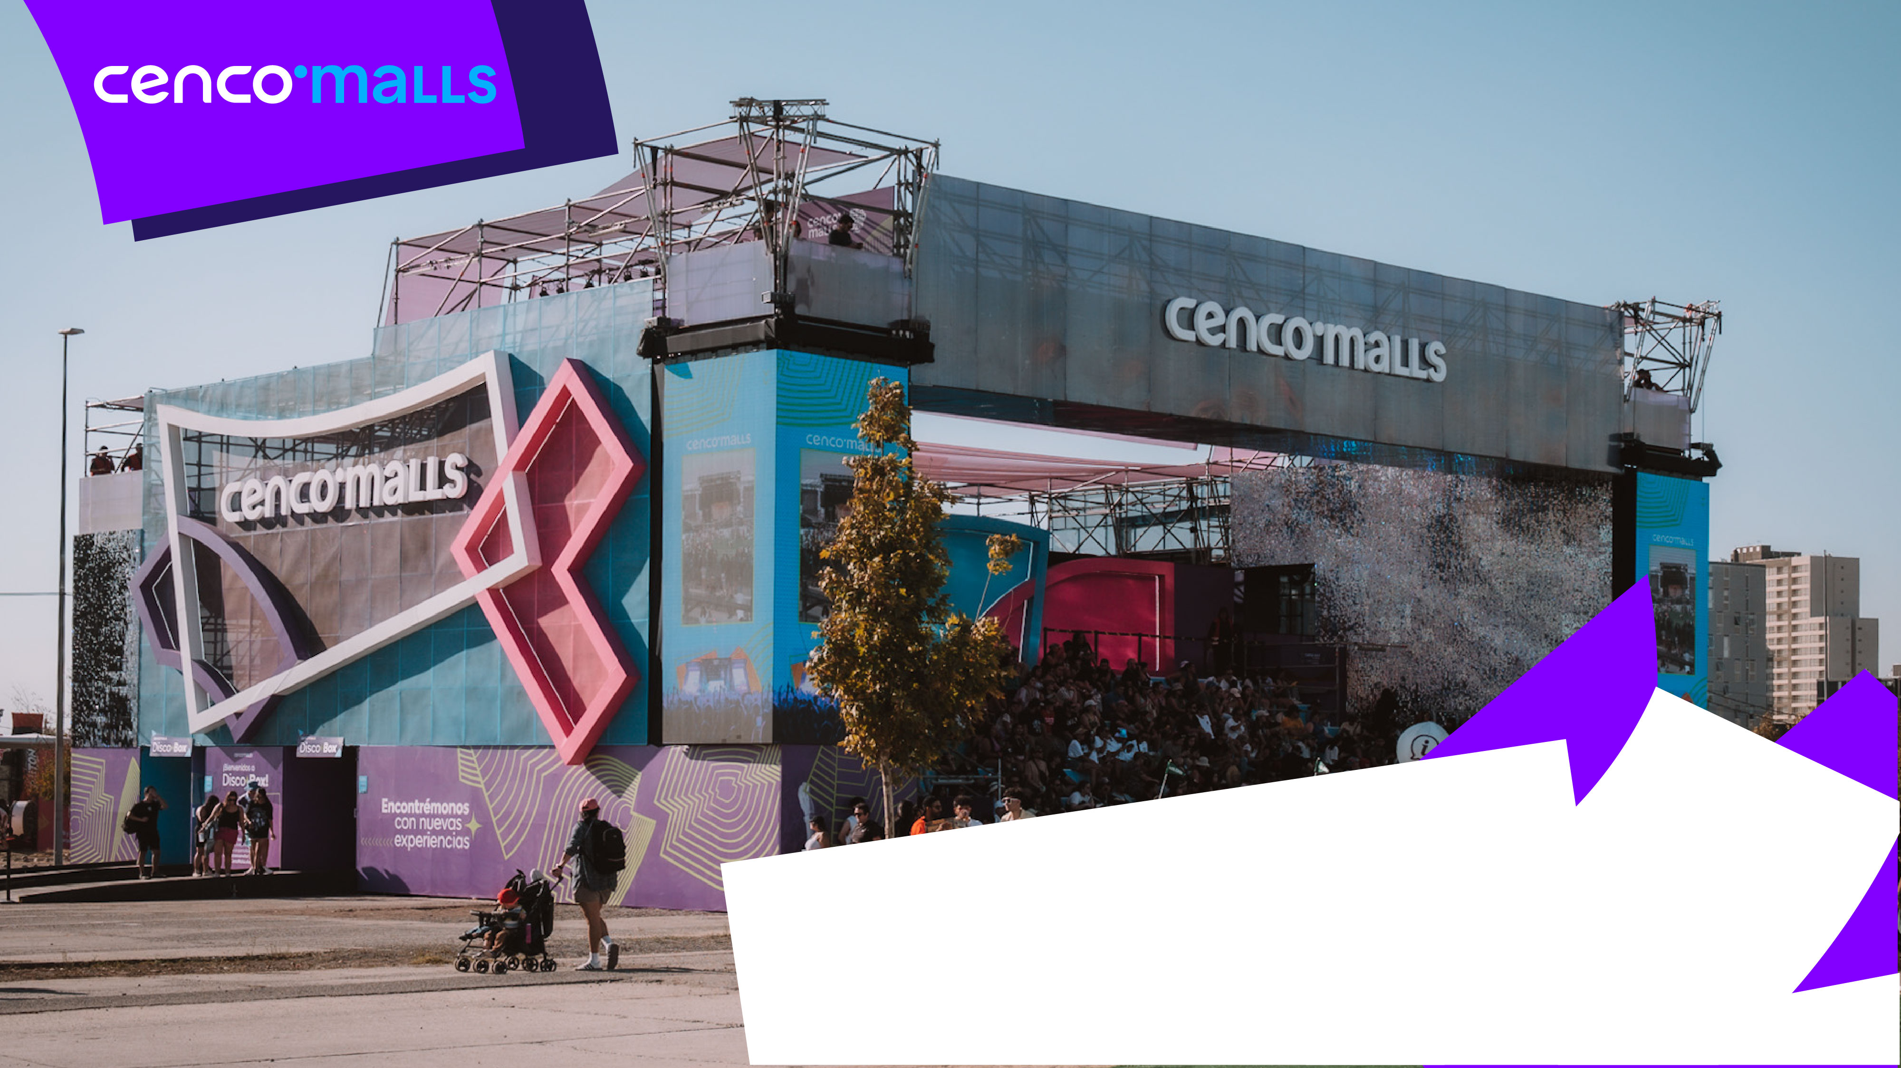
Earnings Presentation
First Quarter 2025

Slide 2

01
Highlights

Slide 3
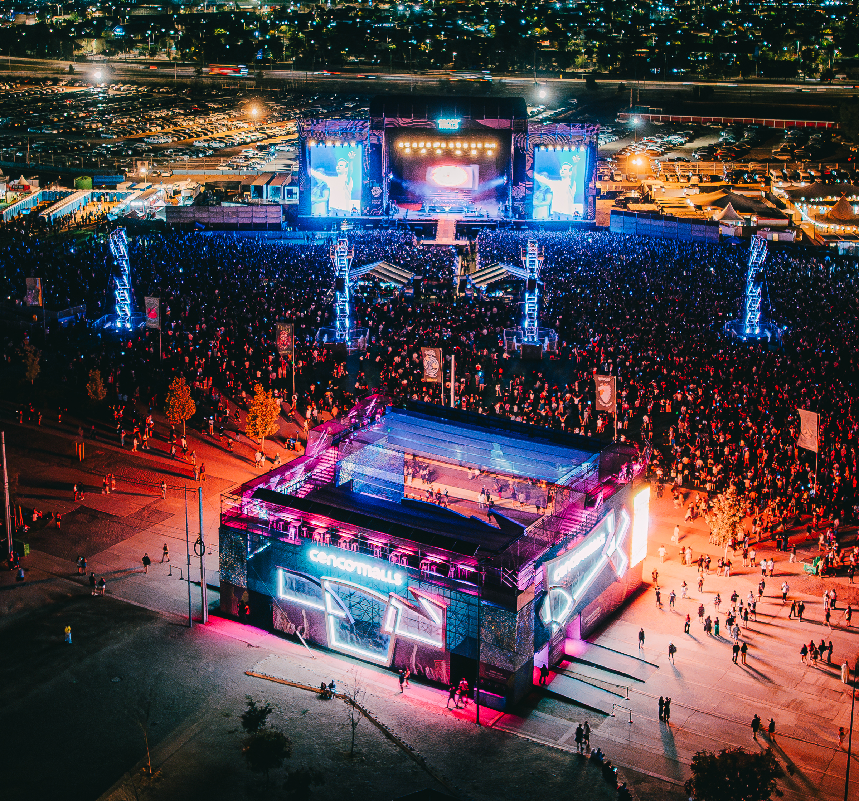

1.1 Highlights of the Period
New Service Areas in Parking Lots
In January, new free service areas were introduced at Cenco Costanera and Cenco Alto Las Condes. These areas include electric vehicle charging stations and tire inflation points, enhancing the visitor experience and supporting sustainable mobility.
Demo Day of CosmoLab by Cenco Malls
Aligned with the strategic focus on innovation, the Company held the Demo Day of CosmoLab by Cenco Malls, marking the conclusion of the open innovation challenge launched in partnership with Bluebox. Four innovation projects were selected to be piloted in Cenco Malls’ shopping centers.
Participation in Lollapalooza Chile 2025
Cenco Malls was the main sponsor of Lollapalooza Chile 2025, an event attended by over 155,000 people. The brand was featured on the Festival’s main stage and participated with three high-visibility activities and distinctive experiences, strengthening Cenco Malls brand positioning and creating memorable experiences for its attendees.
Nonstop Summer Campaign at Cenco Malls
During January and February, the Nonstop Summer campaign was carried out across Cenco Malls’ shopping centers, bringing together over 71,000 attendees at its main activation. The initiative contributed to an increase the Customer Satisfaction Score (CSAT).
Earning Presentation– First Quarter 2025

Slide 4
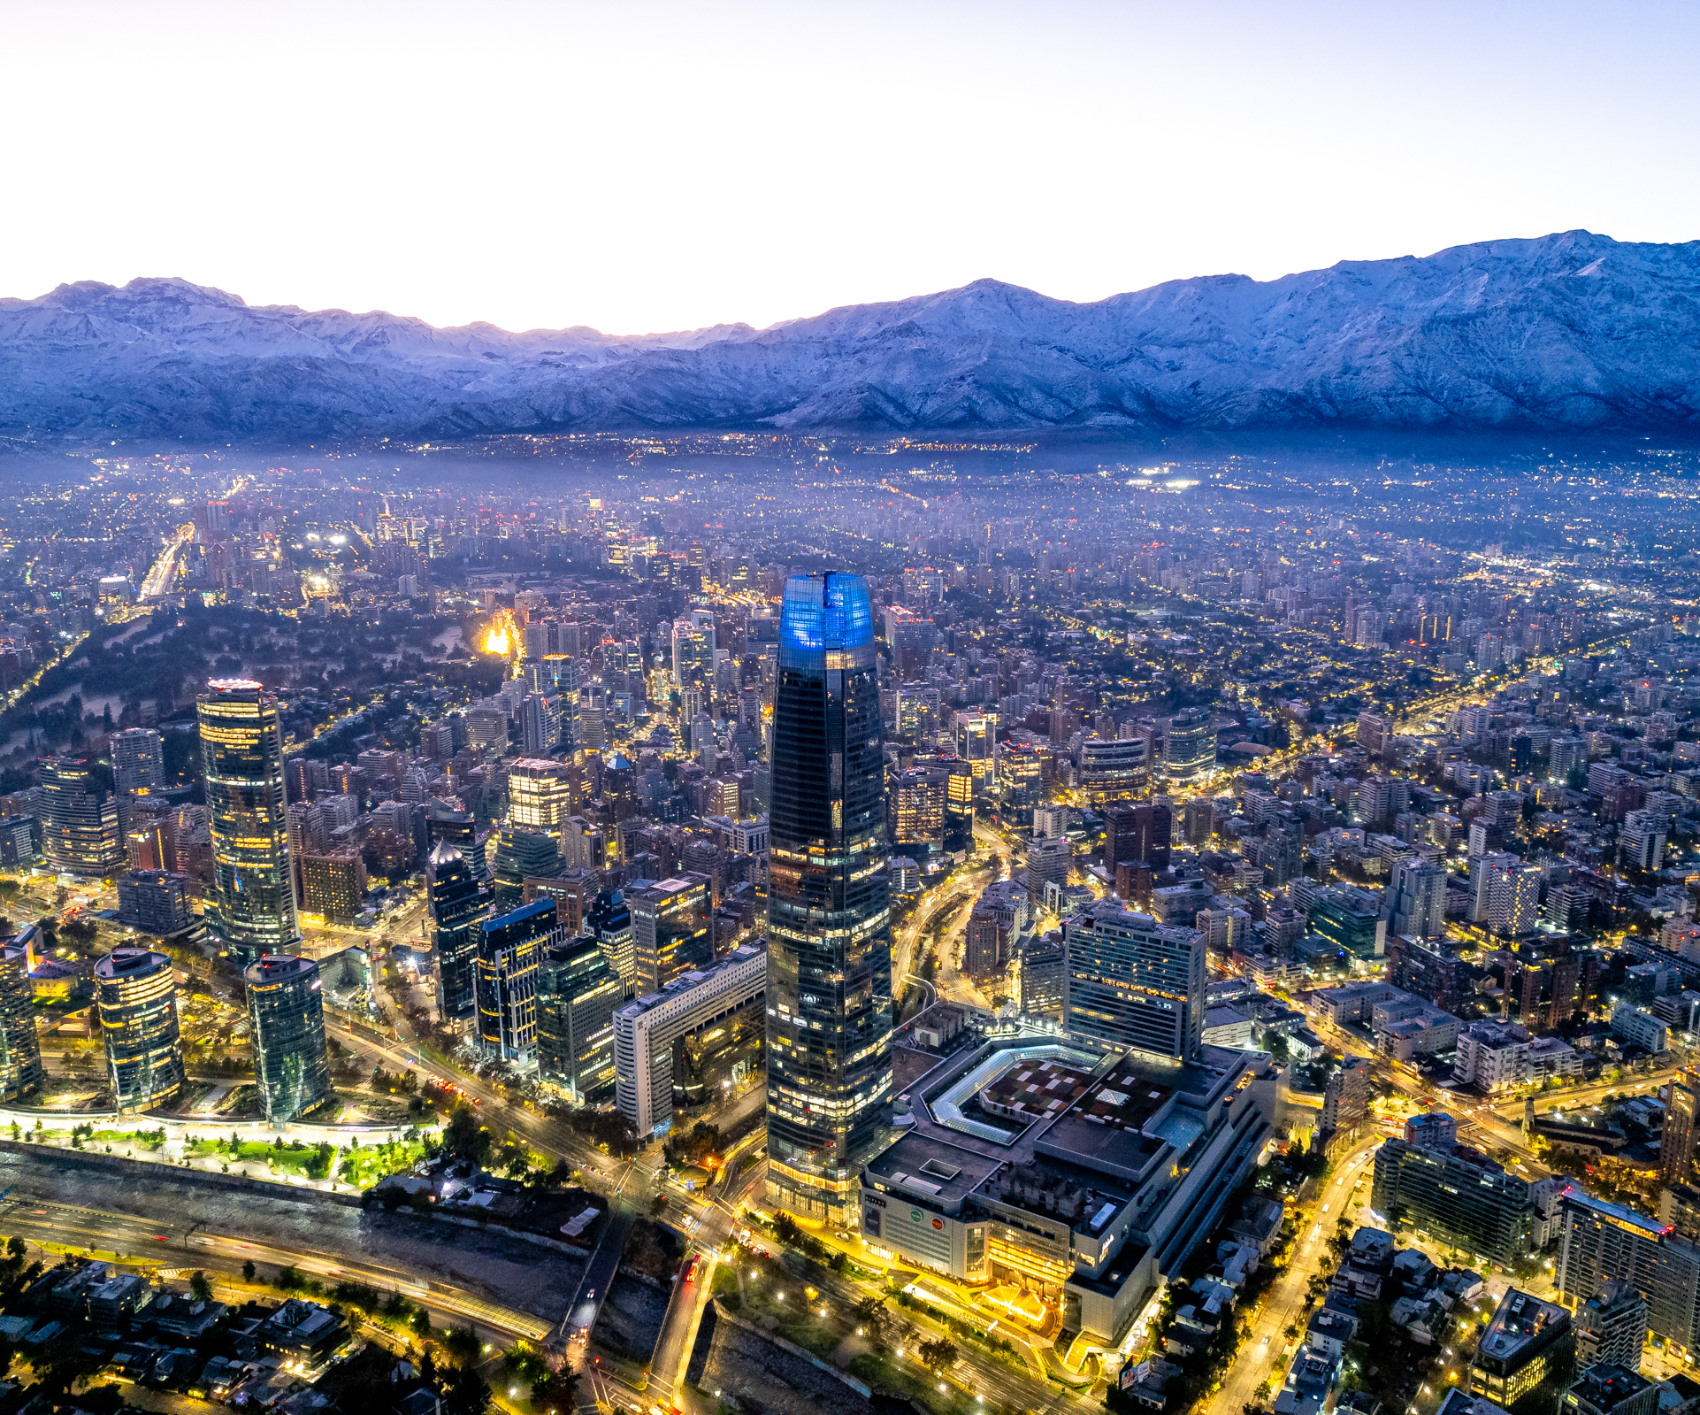
1.2 Events After Quarter-End
Approval and Payment of Dividends Charged to 2024 Earnings
At the 2025 Annual General Shareholders’ Meeting held on April 22, the shareholders’ approved the distribution of a final dividend of $116 per share, representing a dividend yield of 5.7% as of the announcement date.
Publication of 2024 Integrated Annual Report
In April, the Company release the 2024 Integrated Annual Report, outlining the Company’s progress in financial, environmental, social, and governance (ESG) performance, reflecting the commitment to sustainable management.
Earning Presentation– First Quarter 2025

Slide 5
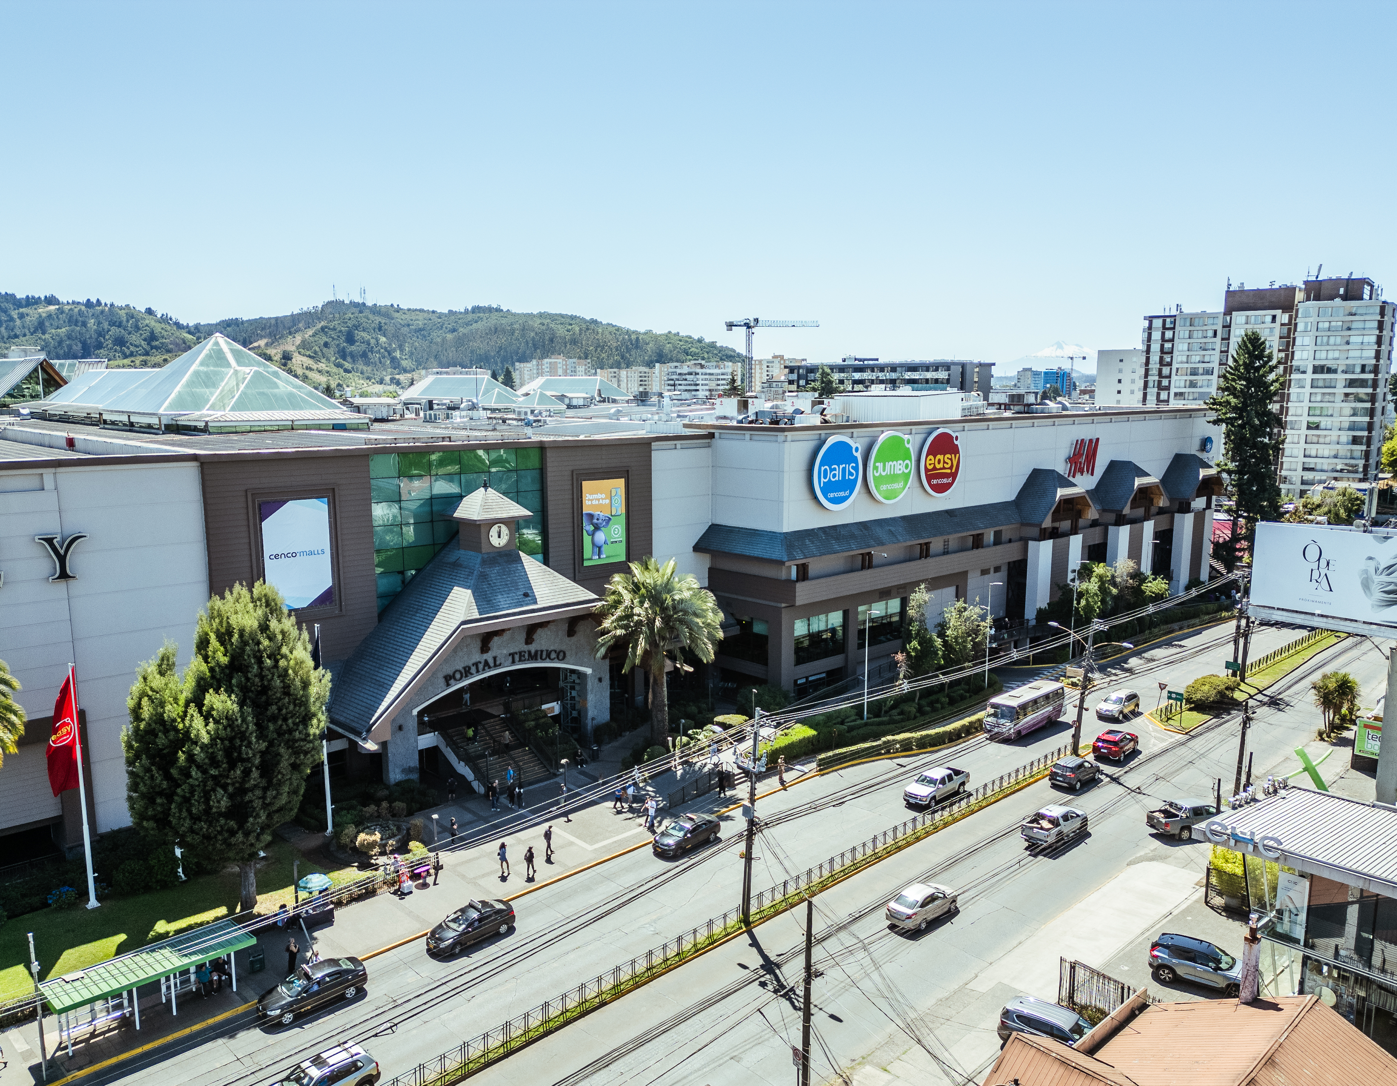
1.3 Investment Plan Key Progress
Cenco Temuco
Approval of Environmental Impact Declaration (DIA) for Expansion
The Environmental Impact Declaration (DIA) was approved on March 26, enabling construction to begin in 2Q25.
The project will add over 16,700 sqm of GLA distributed across 4 levels.
Cenco Costanera
Progress on Ex Paris Gallery and New Vitacura Entrance
Partial opening of the corridor of the new Ex Paris Gallery, providing a new access from Vitacura street and allowing a better monetization of the area.
The stores will continue opening during the second half of 2025.
Progress on 5th Floor Gastronomic Area
Andrés Bello Tower: Tenant fit-outs have begun in the new gastronomic hub (3,190 sqm), with an estimated opening in 2H25.
Vitacura Tower: Opening new restaurants, enriching the mall’s culinary offering.
Winter Garten: Remodeling and public opening of the area, renewing the commercial offering.
Cenco Alto Las Condes
Progress on Food Court
Progress in the relocation and conversion project of the food court.
The opening is scheduled for the second half of 2025.
Earning Presentation– First Quarter 2025

Slide 6

1.4 Investment Plan Key Progress
Cenco Alto Las Condes
Remodeling of Former Ripley Space
Reconfiguration of the former Ripley store area began.
The works will allow for increased revenue through space optimization, renewing the mall’s offering for its visitors.
Cenco Florida
Opening of Stores in Former Johnson Space and Progress of Auto City
A total of 4,200 sqm of new stores were completed in the former Johnson space, while also Auto City continued its progress (~6,000 sqm of additional GLA). Both spaces are in the pre-opening phase, with official openings projected for the second half of 2025.
Gastronomic Hub at Former La Polar Space
Construction of Phase 1 of the new gastronomic hub has begun, involving approximately 4,000 sqm of GLA in the former La Polar space. The project aims to diversify the service offering and strengthen visitor traffic.
Cenco La Dehesa
Opening of New Gastronomic Venues
The opening of new gastronomic venues has begun to strengthen the culinary offering.
These additions aim to enhance foot traffic and improve the visitor experience.
Cenco La Molina (Lima, Perú)
Progress on Phase 2 Works and Start of 5th Floor Intervention
Phase 2 works reached 70% completion, adding over 22,000 sqm of new GLA.
Intervention on the 5th floor has also begun, with an opening targeted for late 2025.
Earning Presentation– First Quarter 2025

Slide 7
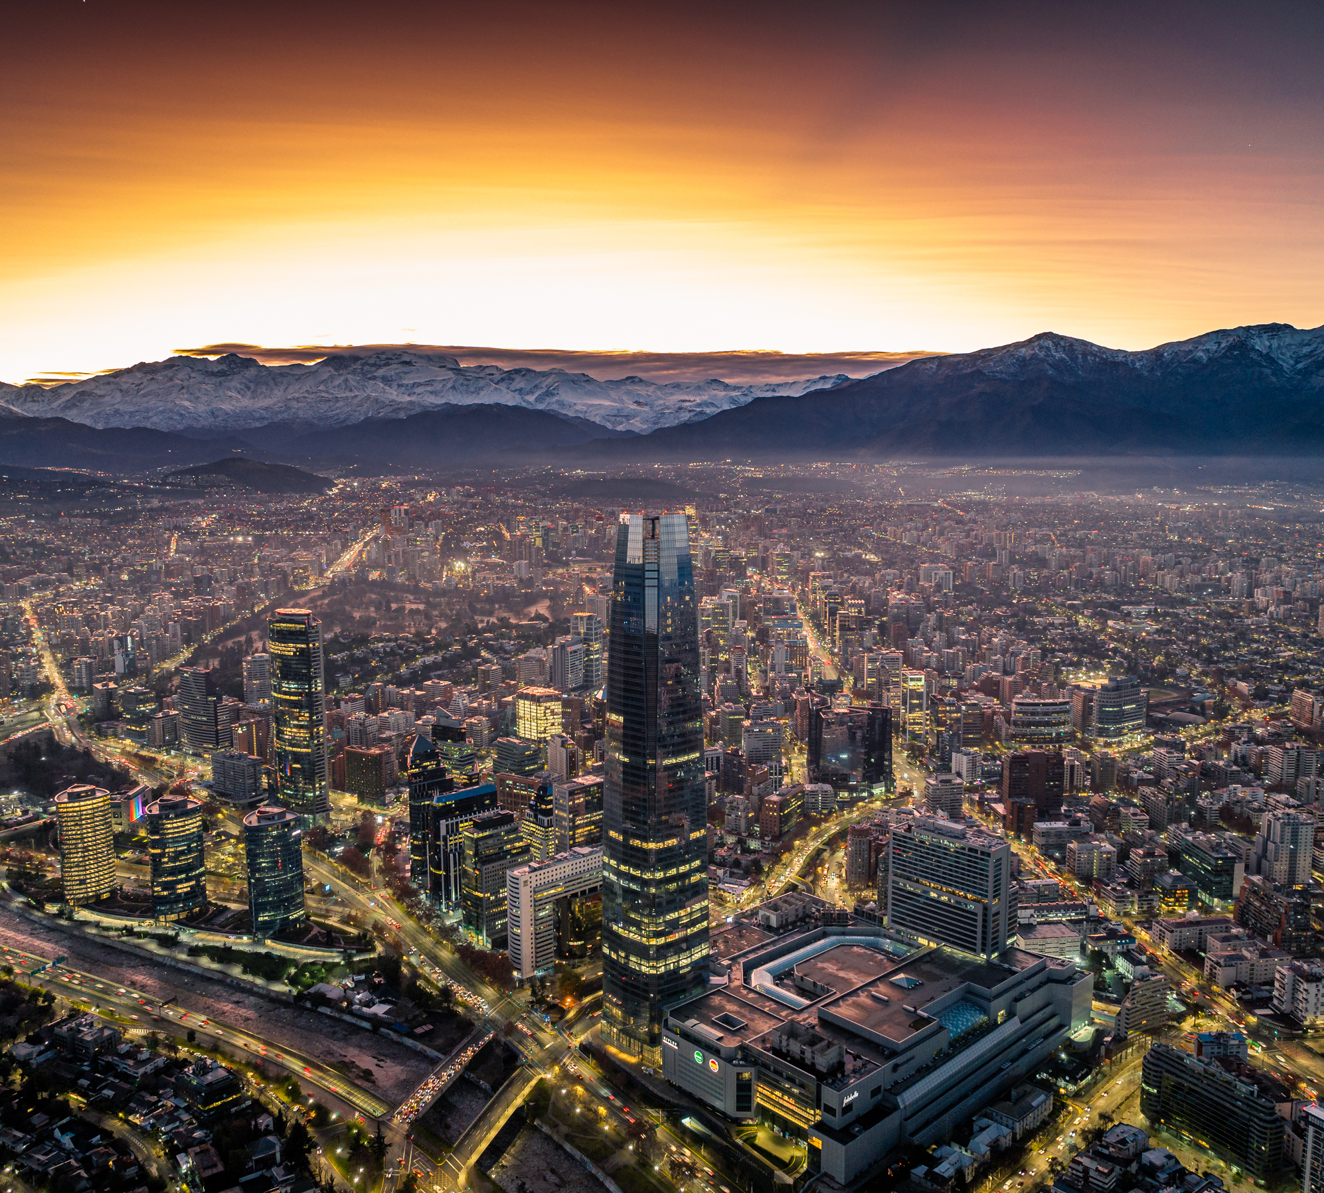
1.5 Investment Plan Key Progress
Cenco Limonar (Cali, Colombia)
Progress on Expansion Works
Significant progress was made on the expansion works, in line with the established schedule.
The project includes over 11,000 sqm of expansion, with completion projected for 2H25.
Parking
Launch of New Parking Operations at Power Centers – Concha y Toro and San Bernardo
New paid parking operations were launched at the Concha y Toro and San Bernardo Power Centers.
These lauches optimize customer service and improve operational profitability.
Offices
Fit-Out Approval for 25,000 sqm in the Tower
Approval was granted for the fit-out of an additional 25,000 sqm of office space in the Costanera Tower, expanding the total offering to 90,000 sqm, primarily in the Gran Torre Costanera’s high-rise section.
Additionally, a lease agreement was signed for approximately 6,000 sqm with Mercado Libre, reflecting the sustained demand for space in Costanera Tower, the tallest in South America.

Slide 8

02
1Q25
Results

Slide 9
2.1 1Q25 Executive Summary
Consolidated Revenues
Consolidated Adjusted EBITDA
(CLP Million)
(CLP Million)
+10.1%
+10.1%
+11.2%
+11.2%
82,016
90,273
82,016
90,273
73,204
81,375
73,204
81,375
1Q24
1Q25
3M24
3M25
1Q24
1Q25
3M24
3M25
Revenue Grows 10.1%, driven by:
Adjusted EBITDA Grows 11.2%, driven by:
  Increase in variable rent due to higher tenant sales.
  Addition of ~20,000 sqm of GLA vs 1Q24.
  Higher fixed income from inflation adjustments in lease agreements.
  Expansion of gross profit by 10.8% YoY.
  Partially offset by higher expenses, mainly related to inflation and team strengthening.
Earning Presentation– First Quarter 2025

Slide 10
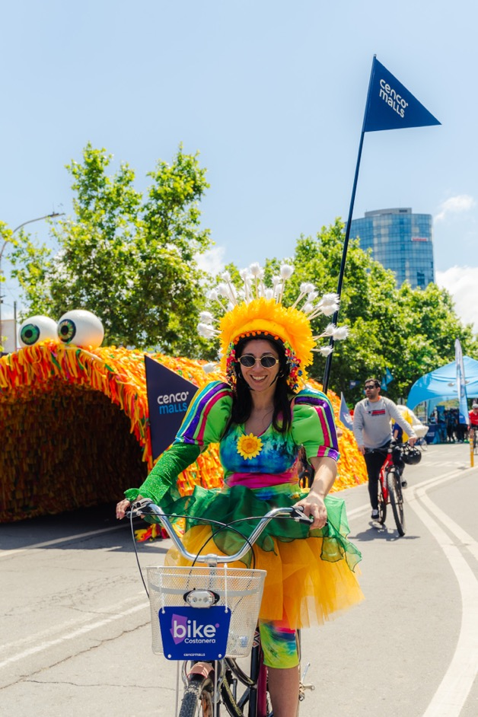
2.2 1Q25 Executive Summary
CLP Million | 1Q25 | 1Q24 | Var. (%) | 3M25 | 3M24 | Var. (%)
Revenues | 90,273 | 82,016 | 10.1% | 90,273 | 82,016 | 10.1%
Adj. EBITDA (NOI) | 81,375 | 73,204 | 11.2% | 81,375 | 73,204 | 11.2%
% Adj. EBITDA (NOI) | 90.1% | 89.3% | 89 bps | 90.1% | 89.3% | 89 bps
FFO | 62,462 | 58,577 | 6.6% | 62,462 | 58,577 | 6.6%
Net Income excl. asset revaluation | 52,540 | 54,529 | -3.6% | 52,540 | 54,529 | -3.6%
Distributable Net Income | 52,524 | 54,539 | -3.7% | 52,524 | 54,539 | -3.7%
FFO (Funds From Operations): During the quarter, FFO increased by 6.6%, reaching CLP 62,462 million. This performance was driven by stronger operational results during the quarter, partially offset by higher tax payments compared to 1Q24.
Distributable Net Income⁽¹⁾: The quarter closed at CLP 52,524 million, reflecting a 3.7% decrease compared to 1Q24. The decline was mainly due to an unfavorable impact from Inflation-Indexed Units (Unidades de Reajuste) and foreign exchange differences.
Earning Presentation– First Quarter 2025
⁽¹⁾ Considers Net Income attributable to the controlling shareholder, excluding the net effect of asset revaluation.

Slide 11
2.3 Revenue Structure
Revenue Breakdown
Contracts Maturity (in years)
71.4%
13.1%
5.9%
5.7%
3.9%
Under 2
Between 2 and 3
Between 3 and 4
Between 4 and 5
Over 5
71.4%
Maturity of over 5
years
~10.2 years ⁽¹⁾
Contracts Average Duration
Earning Presentation– First Quarter 2025
⁽¹⁾ Weighted average of contracts based on their GLA.

Slide 12

2.4 Chile – New Projects Driving Growth and Profitability
Chile
78,709
86,988
78,709
86,988
Revenues
Higher variable rent due to a 10.2% increase in tenant sales.
Addition of ~19,000 sqm of GLA with ~99% occupancy.
Increase in fixed rental income linked to inflation adjustments.
Adjusted EBITDA
Gross profit expanded by 11.3% YoY.
Partially offset by an increase in expenses, mainly related to inflation and team strengthening.
Revenues
Revenues
+10.5% YoY
1Q24
1Q25
3M24
3M25
70,874
79,153
70,874
79,153
Adjusted
EBITDA
Adjusted EBITDA Margin
+95 bps YoY
1Q24
1Q25
3M24
3M25

Slide 13

2.5 Peru – EBITDA Margin Expansion of 1,321 bps
Peru
1,905
1,948
1,905
1,948
Revenues
Cenco La Molina recorded a 76.7% YoY increase in foot traffic, reflecting a higher maturity of the shopping center.
Cenco Lima (formerly San Juan de Lurigancho) showed weaker performance due to lower occupancy and sales.
Adjusted EBITDA
Gross profit expanded by 5.3% in local currency.
Reduction in expenses during the quarter compared to 1Q24.
Revenue
+2.3% YoY in CLP
Revenue
-1.0% YoY in PEN
1Q24
1Q25
3M24
3M25
1,903
1,903
1,604
1,604
Adjusted
EBITDA
Adjusted EBITDA Margin
+1,321 bps YoY
1Q24
1Q25
3M24
3M25
Earning Presentation– First Quarter 2025

Slide 14

2.6 Colombia – Progress Continues on Cenco Limonar for Opening in the Coming Months
Colombia
1,402
1,337
1,402
1,337
Revenues
Improved performance at Cenco Altos del Prado and Cenco Santa Ana
Partially offset by impacts of remodeling and expansion works at Cenco Limonar
Adjusted EBITDA
Increase in property tax expenses
Higher personnel expenses due to the strengthening of organizational structures
Revenues
-4.7% YoY in CLP
Revenues
+0.9% YoY in COP
1Q24
1Q25
3M24
3M25
Adjusted
EBITDA
Adjusted EBITDA Margin
-2,853 bps YoY
1Q24
1Q25
3M24
3M25
Earning Presentation– First Quarter 2025

Slide 15



2.7 Reduction in Occupancy Cost Due to Improved Sales in Chile
Occupancy Cost
SSS
+7.6% ⁽¹⁾
+0.7%
1.5%
1Q25
1Q24
SSR
+8.8% ⁽¹⁾
-2.1%
+5.2%
8.7%
8.8%
8.9%
8.7%
8.8%
7.8%
7.6%
7.0%
Chile
Peru
Colombia
Consol.
Earning Presentation– First Quarter 2025
⁽¹⁾ Figures in local currencies (CLP, PEN and COP, respectively). In UF, the SSS would be 2.8%, while the SSR would be 4.0%.

Slide 16




2.8 Key Operational Figures
Occupancy Rate
Reached 98.2%, remaining stable compared to the same period last year (-5 bps) despite the addition of nearly 20,000 sqm of GLA versus 1Q24.
Visits
Increased by 2.7% YoY, driven by remodeling, expansions, the ongoing development of the tenant mix, and higher tourist traffic.
Tenant Sales
Tenant sales rose 10.2% YoY, boosted by the increase in footfall and stronger capture of tourist spending.
SSR
In Chile, SSR expanded by 8.8% YoY, driven by a higher contribution from variable rent, mainly from Supermarkets and Department Stores. In Colombia, SSR grew 5.2% YoY, primarily reflecting contract updates. In Peru, SSR decline by 2.1% YoY.
98.2%
Occupancy Rate
-5 bps vs 1Q24
+2.7% YoY
Visits
~32,500 million 1Q25
SSR ⁽¹⁾
+10.2%
Tenant Sales (CLP)
vs 1Q24
8.8%
-2.1%
5.2%
Chile ⁽²⁾
Peru
Colombia
Earning Presentation– First Quarter 2025
⁽¹⁾ Figures in local currency (CLP, PEN, and COP, respectively) ⁽²⁾ In UF, SSR would be 4.0%.

Slide 17

v
2.9 Tax and Non-Operating Income
The Non-Operating Result increased significantly compared to 1Q24, mainly due to negative foreign exchange differences—unlike in 1Q24—and a 61.0% higher result from Inflation-Indexed Units versus the same period.
Income tax decreased by 7.6% YoY, driven by a positive variation in deferred taxes compared to 1Q24, partially offset by a 23.6% increase in current tax.
v
Non-Operating Income (CLP Million) | 1Q25 | 1Q24 | Var. (%) |  | 3M25 | 3M24 | Var. (%)
Net Financial Cost | -1,687 | -731 | 130.8% |  | -1,687 | -731 | 130.8%
Exchange Rate Differences | -1,972 | 5,675 | N.A. |  | -1,972 | 5,675 | N.A.
Results of Indexation Units | -9,339 | -5,802 | 61.0% |  | -9,339 | -5,802 | 61.0%
Non-Operating Income | -12,998 | -858 | 1414.2% |  | -12,998 | -858 | 1414.2%
Income Tax (CLP Million) | 1Q25 | 1Q24 | Var. (%) |  | 3M25 | 3M24 | Var. (%)
Deferred Taxes From Asset Rev. | -2,820 | -2,305 | 22.4% |  | -2,820 | -2,305 | 22.4%
Deferred Taxes From Other Concept ⁽¹⁾ | 1,389 | -3,921 | N.A. |  | 1,389 | -3,921 | N.A.
Current Tax | -17,087 | -13,826 | 23.6% |  | -17,087 | -13,826 | 23.6%
Total | -18,519 | -20,052 | -7.6% |  | -18,519 | -20,052 | -7.6%
⁽¹⁾ It includes deferred taxes except those related to asset revaluation. The deferred tax related to asset revaluation is subtracted from the total deferred tax.

Slide 18
2.10 Cash Position
Cash Position Evolution ⁽¹⁾ ⁽²⁾
The cash position showed a positive growth during the period. Notably, the Company’s operating cash flows were sufficient to finance business expansion investments (Capex) and meet financial obligations, while also increasing the cash position by 37.0%.
+37.0%
27,139
1,823
0
1,835
897
157,637
74,279
115,052
Cash Position Dec-24
Operating Cash Flow
CAPEX
Interest Payments
Dividend Payments
Lease Payments
Others
Cash Position Dec-25
⁽¹⁾ Figures in CLP Million. ⁽²⁾ Cash Position includes Cash and equivalents + current financial assets.

Slide 19
2.11 Capital Structure
Financial Indicator | Unit | MAR 25 | DEC 24 | MAR 24
Gross Financial Debt | CLP MM | 747,439 | 737,357 | 713,175
Duration | Years | 9.8 | 10.1 | 10.6
Cash Position | CLP MM | 157,637 | 115,052 | 184,348
Net Financial Debt | CLP MM | 589,802 | 622,305 | 528,827
NFD⁽³⁾/ LTM Adjusted EBITDA | Times | 1.8 | 1.9 | 1.8
As of March 31, 2025, 100% of the Company’s interest rate–exposed debt was contracted at a fixed rate. This debt consist to UF-denominated public bonds.
The average debt duration is 9.8 years.
The average cost of debt is 1.54%⁽¹⁾.
Financial Ratios | Unit | MAR 25 | DEC 24 | MAR 24
Liabilities / Equity | Times | 0.5 | 0.5 | 0.5
Liquidity Ratio ⁽⁴⁾ | Times | 1.8 | 1.8 | 2.2
Debt Ratio ⁽⁵⁾ | Times | 0.3 | 0.3 | 0.3
LTM EBITDA / LTM Financial Expenses | Times | 24.9 | 24.5 | 22.6
LTM FFO / NFD | % | 43.2% | 40.3% | 43.3%
LTM Net Income / Total Asset | % | 6.1% | 6.2% | 5.1%
LTM Net Income / Total Equity | % | 9.3% | 9.4% | 7.6%
Amortization Schedule ⁽²⁾
2029
2044
2045
⁽¹⁾ Annual cost of debt is estimated as the weighted average of the coupon rate for each issue with the
respective amounts issued. ⁽²⁾ Considers capital amortizations. Values are in millions of UF. ⁽³⁾ Net Financial
Debt. ⁽⁴⁾ Current Assets / Current Liabilities. ⁽⁵⁾ Total Liabilities / Total Assets

Slide 20

03
Sustainability
Progress

Slide 21

3.1 Sustainability Progress
Creation of Low-Water-Use Gardens at Cenco Florida
A total of 4,000 sqm of gardens with low-water-demand vegetation were developed in Zone 1 of Cenco Florida. This initiative is expected to reduce water consumption for irrigation by approximately 54%, contributing to more efficient resource management.
National Meeting on Sustainability in Construction (ENASOC)
On April 8 and 9, Cenco Malls participated as a platinum sponsor of the third National Meeting on Sustainability in Construction, held at Sky Costanera. The event convened key industry players to exchange best practices in sustainability applied to the construction sector.
Earning Presentation– First Quarter 2025

Slide 22
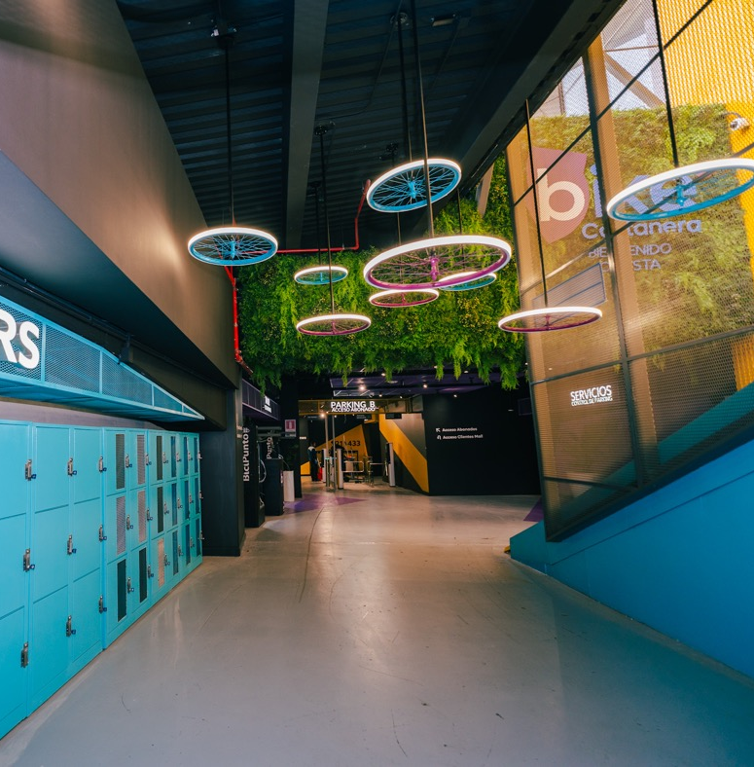
3.2 Sustainability Progress
Participation in Green Building Week from Office HUB Costanera
Cenco Malls hosted the opening day of Green Building Week 2025, organized by the Chile Green Building Council. Held on the 45th floor of Office HUB Costanera, the event showcased the building’s sustainable initiatives
Collaborative Work on Safety and Community Relations at Cenco Altos del Prado
A dialogue session was held with the Municipality of Barranquilla, Colombia, to coordinate actions related to safety, community coexistence, and urban development near the shopping center. This initiative strengthens ties with the local community and reinforces Company’s commitment to the urban environment.
Earning Presentation– First Quarter 2025

Slide 23
Disclaimer
The information contained in this presentation has been prepared by Cencosud Shopping S.A. (“Cenco Malls”) for informational purposes only. It should not be interpreted as a request or offer to buy or sell securities, should not be considered as investment advice or any other form of advice. No guarantee, express or implied, is made regarding the accuracy, completeness, and reliability of the information contained in this document.
The opinions expressed in this presentation are subject to change without notice, and Cenco Malls has no obligation to update the information provided. This document is not intended to be comprehensive.
Cenco Malls and its subsidiaries, directors, and employees accept no responsibility for any loss or damage that may arise from the use of this material, in whole or in part.
This presentation may contain forward-looking statements based on current expectations and projections about future events and trends that could affect Cenco Malls. Please be aware that such statements are not guarantees of the future performance. Numerous factors beyond our control may adversely impact the estimates and assumptions on which these forward-looking statements are based.
Earning Presentation– First Quarter 2025

Slide 24


